Slide 1
UPDATES TO THE CME ACTIVITY REQUIREMENTS
Maine Medical Education Trust

Slide 2
Happy New Year!
How hopeful are you for 2023?
How was your year?
How many stars would you give 2022?
Enter Your Responses in the Poll.
​
How many stars do you predict for 2023?
Enter Your Responses in the Poll.

Slide 3
Happy New Year!
Looking Forward to 2023
What is one thing you are hopeful for this year?
Enter your response on the whiteboard.
​

Slide 4
Agenda
Learner Reporting
Updating the Evaluation Form
Physicians Claiming CME Spreadsheet
CME Passport
Reporting Government Grant Money
Removing the Activity Monitoring Form Requirement
MMET Guide to the CME Activity Approval Process

Slide 5
Learner Reporting
PARS – Program and Activity Reporting System
CME Credits earned by physicians can be directly reported into PARS.
The Maine Board of Licensure in Medicine and the Board of Osteopathic Licensure are 2 of 9 state boards that have agreed to use this reporting system for obtaining CME Credit data for individual physicians’ licensing requirements.
MMET needs to report learners in the PARS system so that Maine Boards can access accurate physician credit information.

Slide 6
Benefits
Reduces Paperwork
Physicians will not need to gather their CME certificates – Boards are able to access all credit information entered for individual learners
Physicians can access a CME transcript from activities entered
Eventually, planners will not need to issue certificates to physicians
A central online CME Credit recording system can help physicians keep track of their earned credits and reduce the time physicians spend on keeping track of their credits and certificates.

Slide 7
Changes for Joint Providers
For MMET to report physician credit, joint providers must:
Update evaluation form to collect additional information from physicians
Prepare and submit a Spreadsheet for Learners Claiming CME

Slide 8
Updating the Evaluation Form
Birthdate (MM/DD)
License ID Number (DO or MD) and State
Whether digital or on paper, the evaluation form will need to ask for additional information from physicians.
Please note that this information is only required for those physicians (MD/DOs) wishing to have CME Credits reported on their behalf.
Number of Credits Claimed
Agreement to have credits reported on their behalf

Slide 9
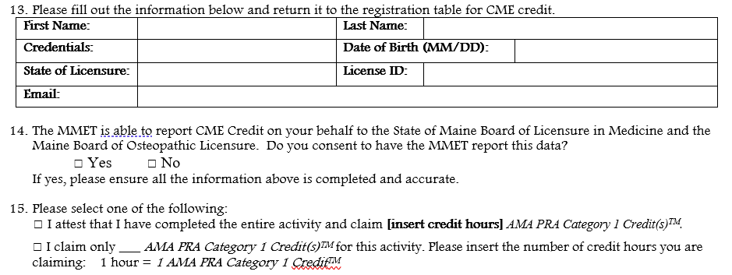
Updating the Evaluation Form

Slide 10
Changes for Joint Providers
For MMET to report physician credit, joint providers must:
Update evaluation form to collect additional information from physicians
Prepare and submit a Spreadsheet for Learners Claiming CME

Slide 11
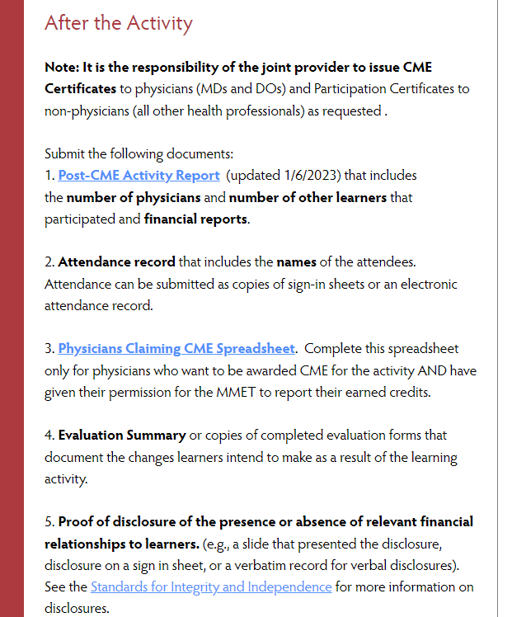
Physicians Claiming CME Spreadsheet
Download from MMET Activity Downloads webpage.
Complete with physician licensing information and credits claimed.
Filled out only for physicians (MDs and DOs) who have agreed to allow MMET to report their earned credit.
To be submitted digitally with Post-CME Activity Materials.

Slide 12
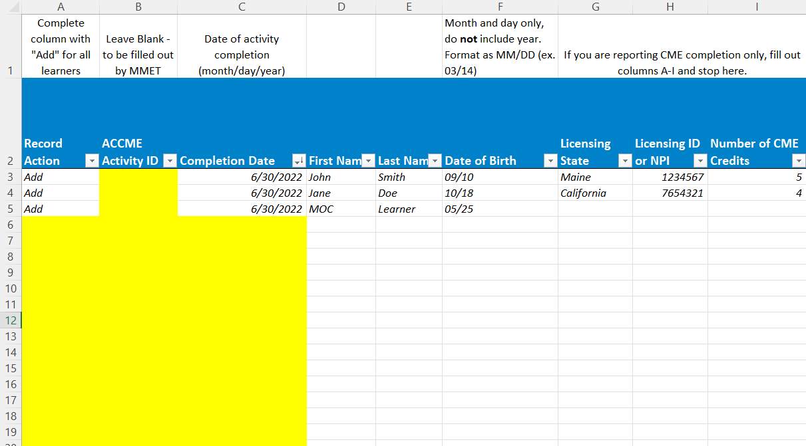
Physicians Claiming CME Spreadsheet
After collecting information from participants in the evaluation forms, transfer the data to learner spreadsheet.

Slide 13
Physicians Claiming CME Spreadsheet
The Spreadsheet has space for reporting both CME and MOC. If reporting just CME, use only columns A-I.
The first three lines provide examples for how to enter data for reporting CME and MOC. They can be deleted before submitting the file.
Do not delete any columns.
All learner information is required.

Slide 14
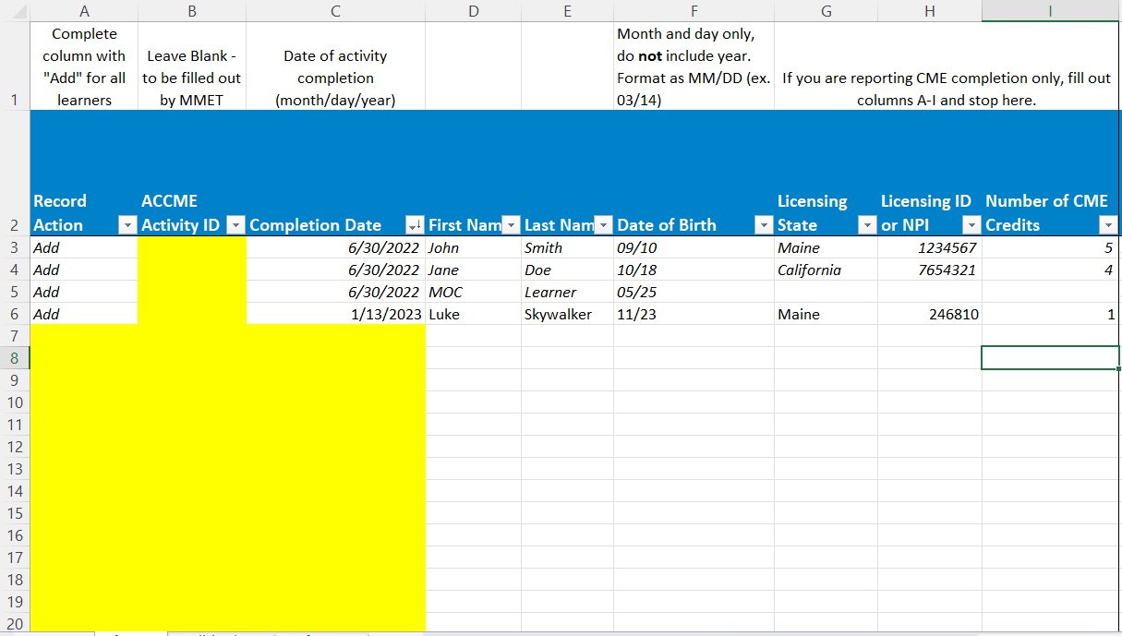
Physicians Claiming CME Spreadsheet
Add a participant. Leave the ACCME Activity ID Column blank.
Highlighted areas mark fields to be filled in.

Slide 15
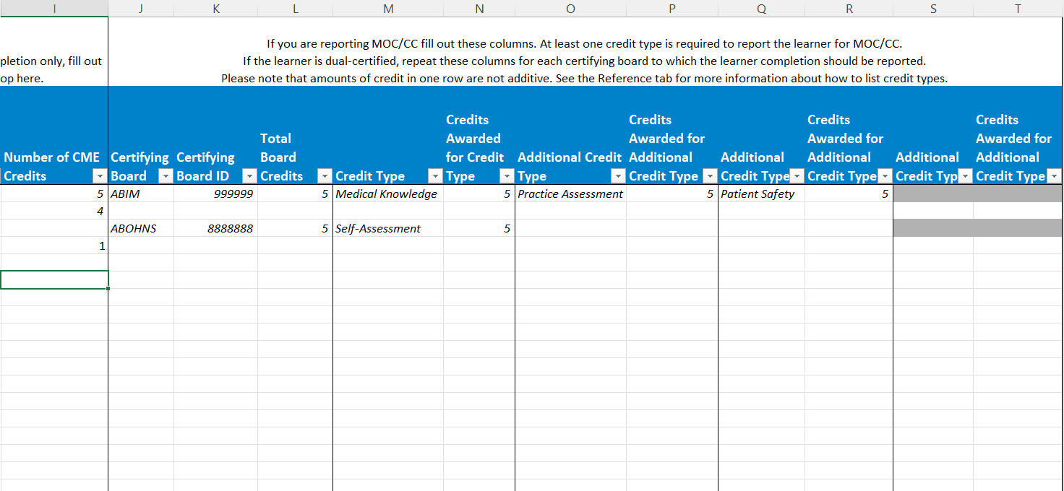
Physicians Claiming CME Spreadsheet
Can report MOC on the Spreadsheet
Do not delete any columns.

Slide 16
Implementing Changes
Activities approved from this date forward will require the submission of an evaluation form that includes the questions necessary to collect the required information from physicians.
Regularly Scheduled Series that have already been approved should update their evaluations by March 31, 2023 and submit the “Physicians Claiming CME Spreadsheet” for each subsequent session.
Enduring materials should update their evaluations by March 31, 2023 and submit a “Physicians Claiming CME Spreadsheet” on a quarterly basis in April, July, October, and January.
Continue to:
Submit an attendance list because not all participants are physicians claiming CME Credit
Report the number of physicians and other learners on the Post-CME Activity Form
Issue certificates to learners for the time being

Slide 17
Agenda
Learner Reporting
Updating the Evaluation Form
Physicians Claiming CME Spreadsheet
CME Passport
Reporting Government Grant Money
Removing the Activity Monitoring Form Requirement
MMET Guide to the CME Activity Approval Process

Slide 18
How many of you are familiar with CME Passport?

Slide 19
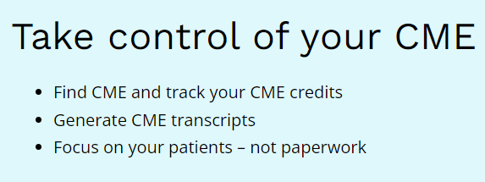
What is CME Passport?
CME Passport is an online database that can house both CME Activities and Learner CME Transcripts.
It is not a requirement to include your activity on CME Passport or for physicians to create an account, but there are benefits to providers, planners, and learners.

Slide 20
Benefits of Using CME Passport
FREE ADVERTISING FOR ACTIVITIES
Planners can select whether to include their activity in CME Passport on the CME Activity Application.
Must enter a URL if selecting to include the activity on CME Passport
Learners can search for activities on CME Passport.
This allows the activity to potentially reach a wider audience.

Slide 21
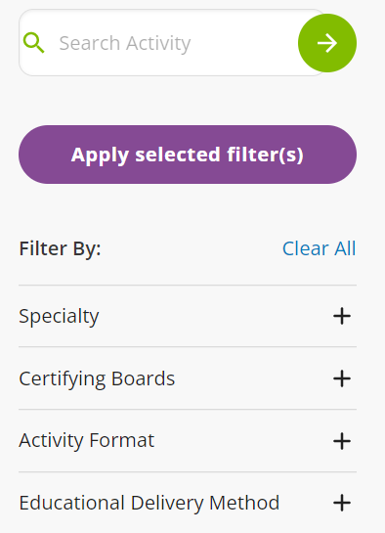
Benefits of Using CME Passport
LEARNERS CAN FIND ACTIVITIES
Learners can search a database of activities from around the nation to find ones that meet their needs.
This includes both live and enduring materials and activities offering MOC.
A filter allows them to narrow their search.
Anyone can use the search tool.

Slide 22
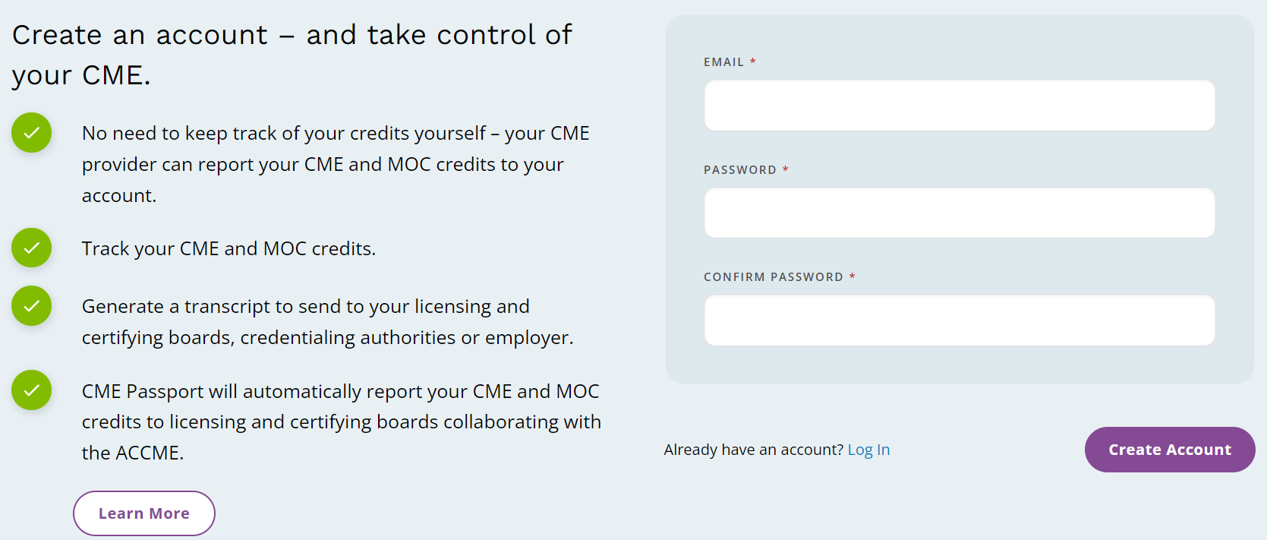
Benefits of Using CME Passport
LEARNERS CAN MANAGE THEIR CME CREDITS
CME Passport allows learners to keep track of the credits they earn.
As providers upload credits earned in PARS, learners can view a transcript of their credits if they create an account.
Potentially reduces time spent issuing CME Certificates and handling inquiries regarding certificates.

Slide 23
Benefits of Using CME Passport
CREDIT REPORTING
The State of Maine Board of Licensure in Medicine and the Maine Board of Osteopathic Licensure are 2 of 9 state boards (and growing) that have collaborated with the ACCME to use CME Passport for reporting physician credit.
This reduces the administrative burden on physicians for tracking and reporting their credits. Physicians can download a transcript and email it directly to the Board if necessary.

Slide 24
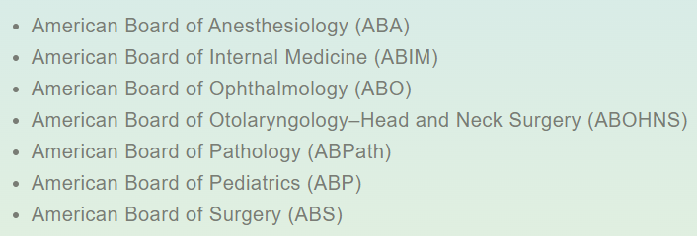
Benefits of Using CME Passport
TRACKS CME CREDITS FROM ALL REPORTING PROVIDERS
Physicians often earn CME credits from a variety of providers.
CME Passport is able to act as a single source of CME Credits earned if all providers are entering learner data into PARS.
MOC is also reported to all collaborating certifying boards.

Slide 25
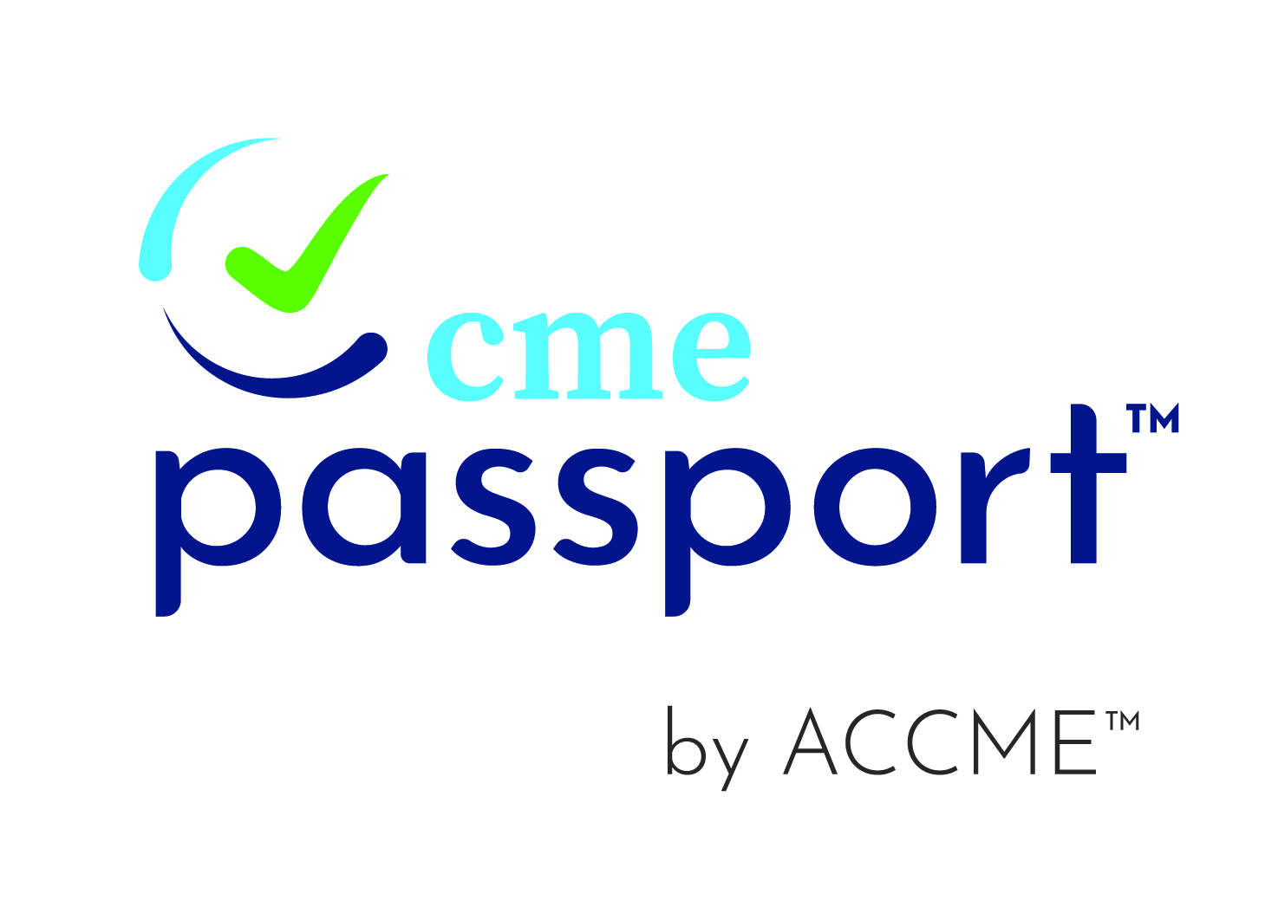
Informing Learners of Using CME Passport
The CME Provider Passport Mark can be included on announcements and brochures to let learners know that the credits will be available on their CME Passport Transcript.
The Mark can be downloaded from the ACCME website.

Slide 26
Informing Learners of Using CME Passport
The following language can be used on activities to accompany the CME Passport Provider Mark:
"The CME credits that physicians earn from this activity will be submitted to ACCME's CME Passport, a free, centralized web application where you can create a personalized account to view, track, and generate transcripts of your reported CME credit. Visit www.cmepassport.org to create your account."

Slide 27
Agenda
Learner Reporting
Updating the Evaluation Form
Physicians Claiming CME Spreadsheet
CME Passport
Reporting Government Grant Money
Removing the Activity Monitoring Form Requirement
MMET Guide to the CME Activity Approval Process

Slide 28
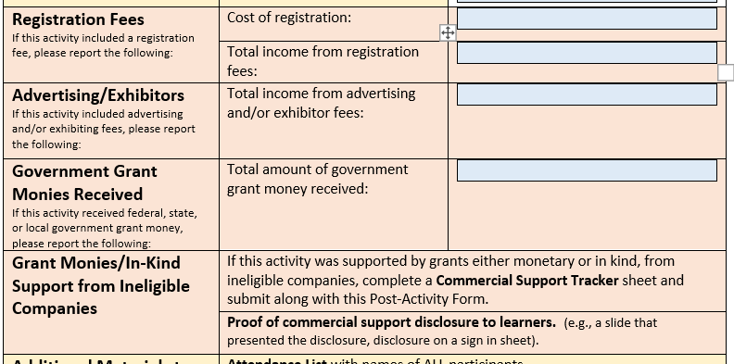
Reporting Government Grant Money
The MMET is responsible for reporting monetary grants received from federal, state, or local governmental agencies for CME Activities to the ACCME.
Do not need to account for the allocation of the money received.
Money is reported as a total for the year, not on an individual activity level.
Report Government Grant Money Received on the Post-Activity Report Form

Slide 29
The Activity Monitoring Form is No Longer Required
This form was completed for each activity to comply with an old standard that is no longer a requirement.
Continue to ensure disclosures are being made and presentations are free from bias.

Slide 30
Agenda
Learner Reporting
Updating the Evaluation Form
Physicians Claiming CME Spreadsheet
CME Passport
Reporting Government Grant Money
Removing the Activity Monitoring Form Requirement
MMET Guide to the CME Activity Approval Process

Slide 31
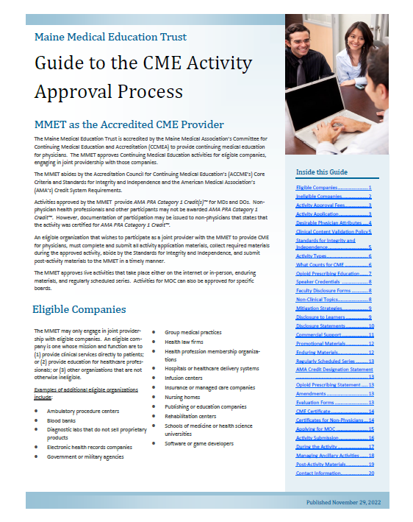
MMET Guide to the CME Activity Approval Process
Includes information and instructions on
Submitting for Approval
Instructions for During the Activity
Post-Activity Requirements

Slide 32
Next Steps
Update Evaluation Form
Download the MMET Guide to the CME Activity Approval Process
Download the Physicians Claiming CME Spreadsheet
Begin making changes now to prepare for upcoming activities
Add the CME Passport Mark to Brochures and Announcements
Encourage Physicians to Create a CME Passport Account

Slide 33
Check-In
On the Scale of Lego Pain, How painful do you think the changes discussed today will be for you and your organization?
Enter Your Responses in the Poll.
​

Slide 34
Check-In
What do you see as the greatest benefits to Learner Reporting?
What do you see as the major obstacles to implementing these changes?
What additional support do you think you might need to make these changes?
Enter Your Responses in the Whiteboard.
​

Slide 35
Questions?
Contact
Elizabeth Ciccarelli, Director of Continuing Medical Education
Maine Medical Education Trust
eciccarelli@mainemed.com

Slide 36
Office Hours
Mondays from 9-10am
Beginning Monday, January 23rd
Zoom Link to be Sent
Next Upcoming Session
Issuing Certificates – Updates to the CME Process
– Monday, February 6th at 10am
Contact
Elizabeth Ciccarelli, Director of Continuing Medical Education
Maine Medical Education Trust
eciccarelli@mainemed.com

